Slide 1

Razer
For gamers by gamers

Slide 2

Introduction
4-5 minutes
Razer produces game gear

Slide 3
content
What is razer ?
The history of Razer
The Razer products
The Razer website

Slide 4
What is razer ?
Razer is a producent of game gear
Established in the USA
For gamers by gamers
Perfection
A lot of sponsorship

Slide 5
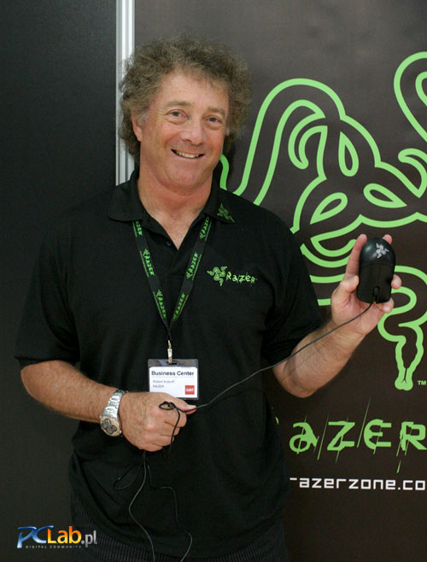
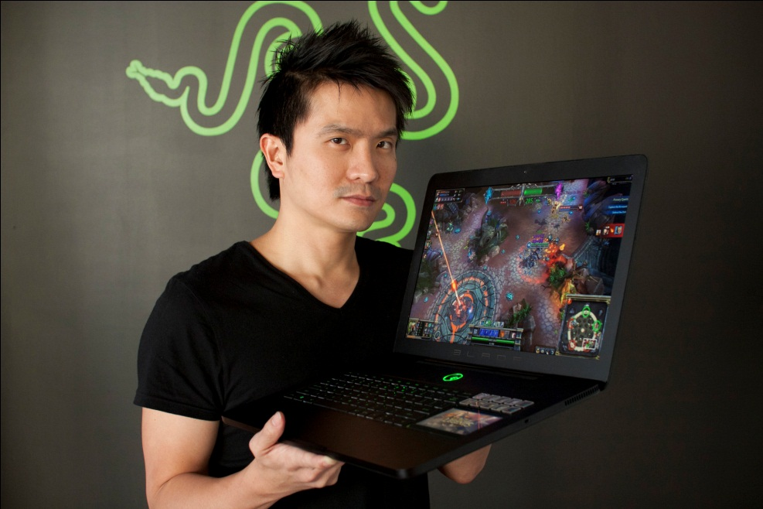
The history of razer
1998:Established under Karna LLC
2000: first main sponsor for a gaming tournament
2005: Razer was sold to Krakof
President: Rober ‘Razerguy’ Krakof
CEO: Min-Liang Tan
Market leader

Slide 6
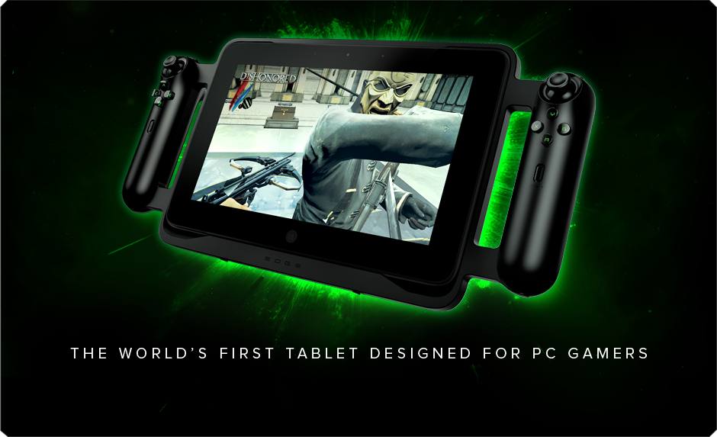
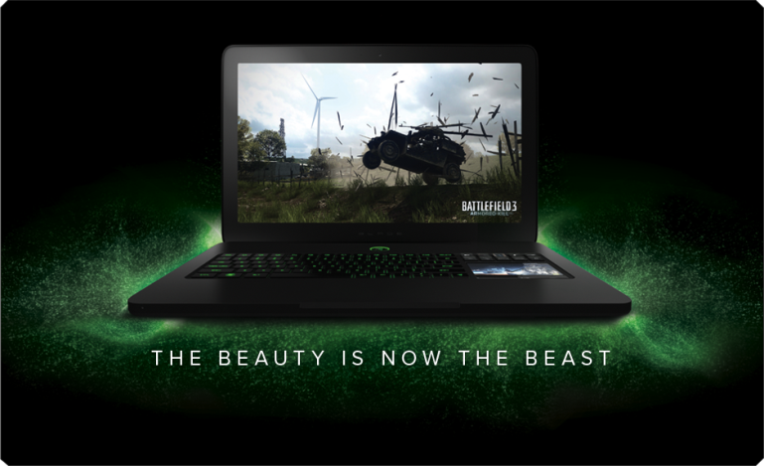
The razer procuts
Hardware
Gaming systems

Slide 7
The razer website
A lot information
April fools jokes
Links to youtube
Webshop is regional

Slide 8
conclusion
Razer is specific for gamers
Works for perfection
Own company

Slide 9
Are there any questions ?

Slide 10

The End

